Slide 1
The Proof and Fruit of Knowing God
1 John 2:3-6

Slide 2


Slide 3


Slide 4


Slide 5
Antichrist Exposed
1 John 2:18-27

Slide 6


Slide 7


Slide 8
Satan’s Great Lie
1 John 3:4-10

Slide 9
The Love the World Loves to Hate
1 John 3:11-18

Slide 10


Slide 11


Slide 12
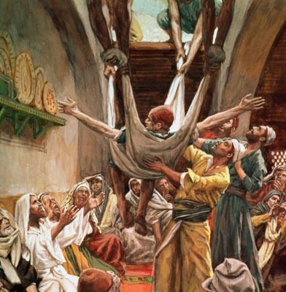
Their Tenacious Faith
Various Scriptures

Slide 13
Keeping the Greatest Commandment
1 John 4:7-12

Slide 14


Slide 15
Divine Math and the Child of God
1 John 5:1-5

Slide 16


Slide 17

S E R I E S O N 1 J O H N
THE GIFT OF
ETERNAL LIFE

Slide 18


